Slide 1
Pharmacy Systrm

Slide 2
Goal
Because of the spread of technology in all fields and its facilitation of many things, the system will reduce the descent of the elderly and patients with infectious diseases, and thus we will make it easier for the elderly to obtain medicines easily and protect ourselves from people with infectious diseases, once they visit the pharmacy website and enter some information They will get their medication without having to go down. The system will also help in the process of storing medicines, listing available and unavailable medicines and using online system become more useable after COVID-19

Slide 3
1
Let’s start with the first set of slides

Slide 4
Features.
i. The system will reduce the descent of the elderly and patients with infectious diseases
ii. The system will also help in the process of storing medicines, listing available and unavailable medicines
Iii-there will be no chance of having a lot of workers
iv. Record all medications that have been taken out through the pharmacy website and the pharmacy branch

Slide 5
More about our system
Our system targeting ,Most of the customers target the elderly and people with diseases who are unable to go to buy medicines
System will be friendly use, customer will sign in and has some access and worker also will sign in and have more accesses

Slide 6
System Overview
Customer will sign in in the site and will choose the Section
And will search about his goal if he found it will choose it and choose method of pay and then closed the site or if he do not find his goal he can put it in some thing called wanting list to know the pharmacy to bring it then exit or exit directory .
Workers will have more accesses, they will sign in and can add items to the system or check orders and wanting list or can contact to pharmaceutical companies
This system will save time and effort, This project will use will follow agile method it will be online website

Slide 7
In two or three columns
functional requirements
Store Medicine data's.
Search Medicine data effectively.
Update, delete, and Edit medicine information.
Generate report on medicine. Prepare bill for the medicine.
Gives navigation or information for pharmacy organization.
Give alert for the user when medicine item is low.
Changing login password.
Have the system document how to use the system.
Nonfunctional requirements.
Usability : it user friendly user interface Which have the instruction menu's how to use it which self directive application then can be used the system .
Reliability: The pharmacy system is available based on the user needs, can work properly, and do transactions efficiently including safe data management of the pharmacy. For invalid and malfunctioned operation the system will restart in order to prevent data loose as well as sale operation within 5 seconds. The pharmacy system is password protected to change things on the system.

Slide 8
More non functional requiernment
Performance: The pharmacy management system operates its function in small amount of time which in less than two seconds and can be accessed by one user at a time or concurrently.
User interface: the user interface is friendly which is easy to use. the user can change him/her user favorite interfaces that is available in the system Operation
the pharmacy management system is operated and controlled pharmacy manager for safe work

Slide 9
diagrams to explain your ideas

Slide 10
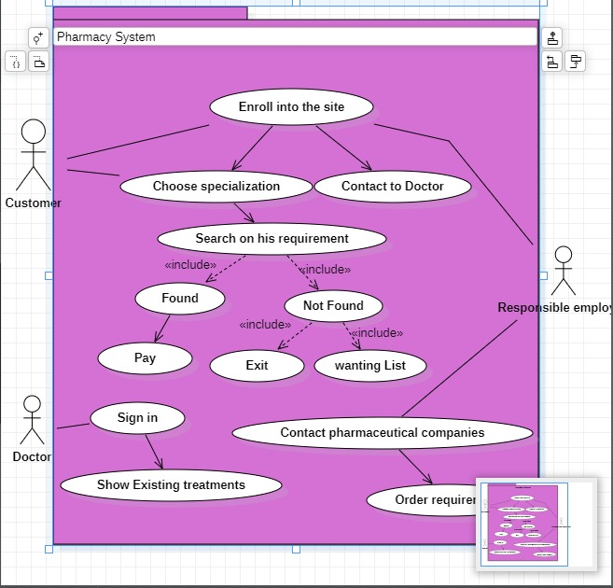
And this is the use case Diagram for our System

Slide 11
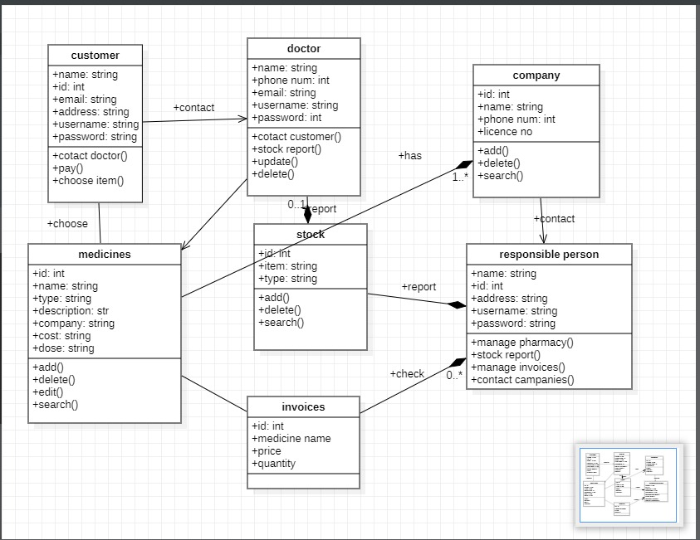
Class Diagram

Slide 12
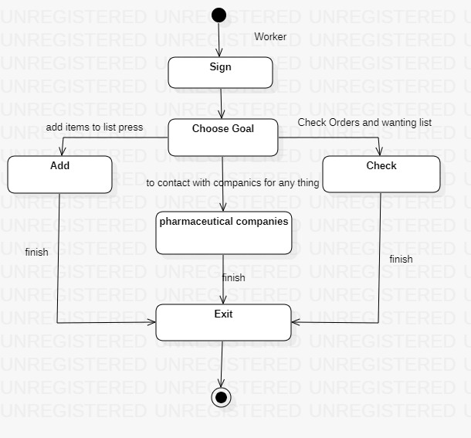
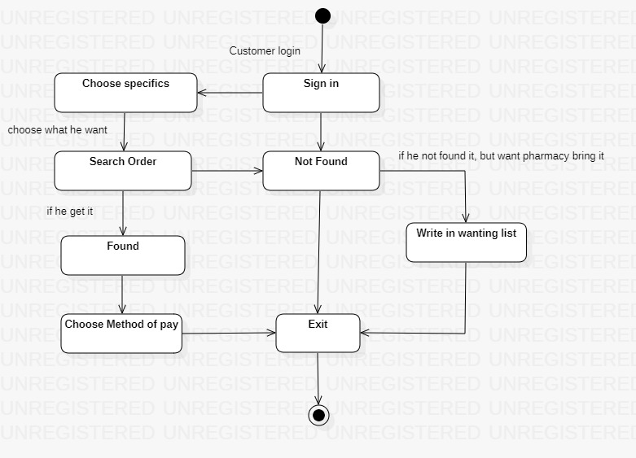

Slide 13
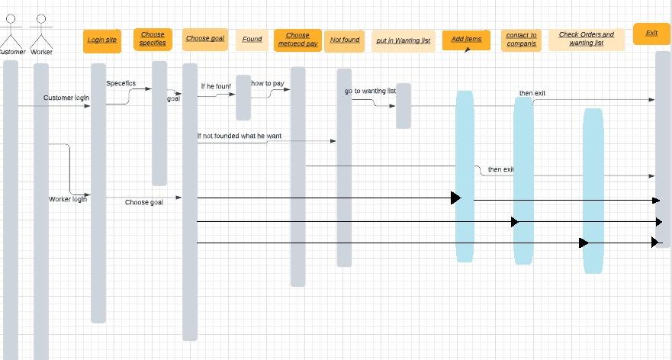
Sequence Diagram

Slide 14
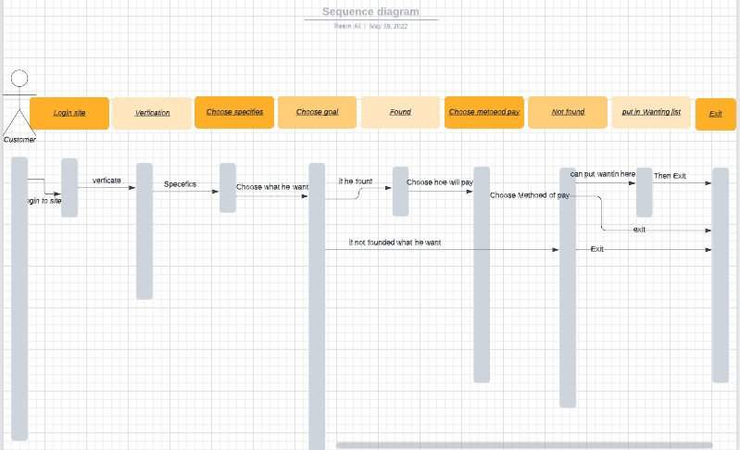
Another Sequence Diagram for Customer only

Slide 15
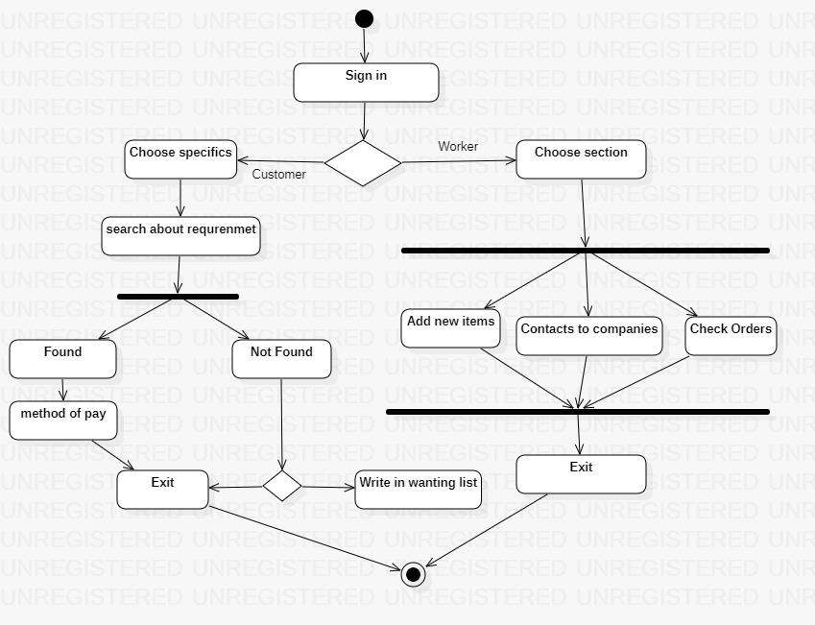
Finally We have Our Activity Diagrams

Slide 16
Thanks!

